Slide 1
Finders Keepers
Missing Law Clients and Deceased Attorney Escrow Accounts.
Can Your Fund Benefit?
Presented by: Trinity M. Braun-Arana Director of Client Security Iowa Office of Professional Regulation | Michael J. Knight, Sr. Executive Director & Counsel NYS Lawyers’ Fund for Client Protection

Slide 2
ABA Model Rules for Lawyers’ Funds for Client Protection
RULE 3. FUNDING
A. The Court shall provide for funding by the lawyers admitted and licensed to practice law in the jurisdiction in amounts adequate for the proper payment of claims and the costs of administering the Fund.
Comment
[1] Paragraph A suggests that the single most important factor in establishing and maintaining an effective client reimbursement program is ensuring adequate and continuous funding through a reliable source. The Court, pursuant to its power to regulate lawyers and the practice of law, has the power to impose a fee to support the regulatory system. In the exercise of its authority, the Court may assess lawyers an annual fee to finance systems that implement the Court’s regulatory authority.
NCPO Standards for Evaluating Client Protection Funds
 | 2.1 The Fund must have a source of income that is steady, secure and adequate to meet its standards of accessibility and responsiveness. Commentary Client protection is a field in which good intentions are not enough. A Fund in hiding or unable to meet the need cannot be considered a Fund at all. In many ways, funding is the ultimate Fund issue. Not only must funding be adequate, but it must be steady - every year or every other year - and secure. Given the Fund's importance to maintaining trust and respect within the legal profession, it cannot be permitted to go begging each year with clients' financial viability hanging in the balance.

Slide 3
Standard/Traditional Revenue Streams
Nearly All Client Protection Funds Receive Income From:
Annual Assessment/Registration Fees/ Budget Appropriation
•
•
Restitution/Litigation
These sources, however, may not be sufficient alone to provide meaningful
reimbursement to victims.
•
Investments/Interest Income

Slide 4
Pros and Cons of Alternative Revenue Streams
Passive income – no heavy lifting.
Provides statutory framework to assist attorneys with Trust
Account reconciliation (Missing Client/Deceased Atty).
May provide relief from rigid dependence on finite,
traditional or erratic funding limits.
Income stream(s) are not consistent.
May require development of additional
oversight/monitoring protocols
Unable to budget for passive income.
Public policy served with opportunity to deliver more
meaningful client protection to law client victims.
May permit your Fund to avoid requesting additional Pros outweigh the Cons
assessments/appropriations.

Slide 5
Unclaimed/Missing Client Funds

Slide 6
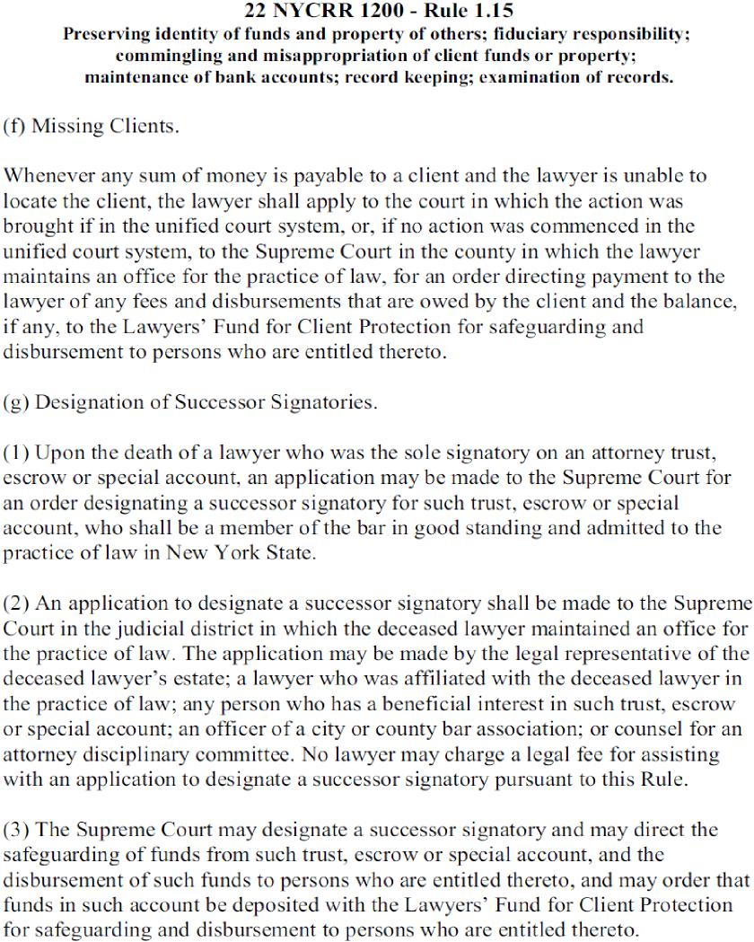
New York’s rules were developed in 1994 after the death of a sole practitioner on Long Island whose attorney escrow account was inaccessible to clients.
With the Nassau County Bar Association, the New York Lawyers’ Fund proposed amendments 1.15 (f) and (g) to the Administrative Board of the Courts which were adopted as part of our trust accounting and recordkeeping rules.

Slide 7
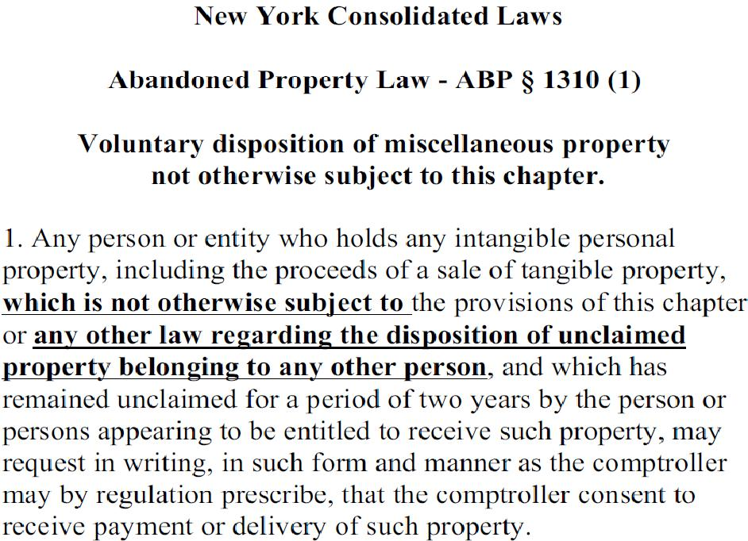
Review Your State’s APL

Slide 8
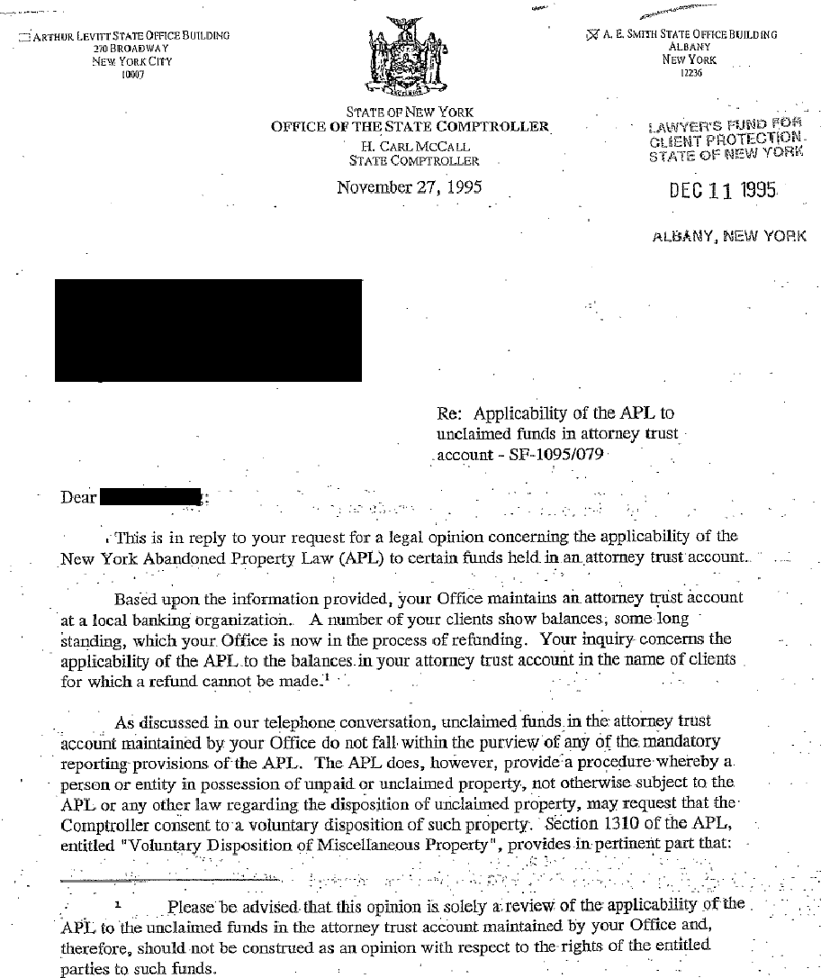
In 1995, the NYS Comptroller’s Office
provided an opinion letter which
determined that Court rules, not the
Abandoned Property Law, governed
the disposition of unclaimed funds in
attorney trust accounts.

Slide 9
Missing Clients – 1.15(f)
1.15 (f) provides:
Missing Clients. Whenever any sum of money is payable to a client and the lawyer is unable to locate the client, the lawyer shall apply to the court in which the action was brought if in the unified court system, or, if no action was commenced in the unified court system, to the Supreme Court in the county in which the lawyer maintains an office for the practice of law, for an order directing payment to the lawyer of any fees and disbursements that are owed by the client and the balance, if any, to the Lawyers’ Fund for Client Protection for safeguarding and disbursement to persons who are entitled thereto.
Unable to locate the client.
Application to court in which the action was brought or the Supreme Court in the county where lawyer maintains an office.
Order directing payment to the lawyer of any fees and disbursements owed and the balance to the Lawyers’ Fund.
Fund safeguards and disburses to persons who are ‘entitled thereto’.

Slide 10
Missing Clients – 1.15(f)
1.15 (f) provides:
Missing Clients. Whenever any sum of money is payable to a client and the lawyer is unable to locate the client, the lawyer shall apply to the court in which the action was brought if in the unified court system, or, if no action was commenced in the unified court system, to the Supreme Court in the county in which the lawyer maintains an office for the practice of law, for an order directing payment to the lawyer of any fees and disbursements that are owed by the client and the balance, if any, to the Lawyers’ Fund for Client Protection for safeguarding and disbursement to persons who are entitled thereto.
‘Unable to locate’ has been interpreted to include unidentified deposits or funds that are ‘unknown’, i.e. where the beneficial owner of the funds cannot be established.
The rule is a ‘safe-harbor’ for lawyers/law firms to remit funds to the Lawyers’ Fund with no disciplinary repercussions. The attorney/firm is still in trust, despite an inability to identify ownership of funds.
The Lawyers’ Fund has no authority to determine entitlement to an unidentified/unknown deposit. If a purported beneficial owner contacts the LFCP claiming entitlement to any portion of an unidentified/unknown deposit, the inquiring party is directed by the LFCP to contact the Court which issued the original deposit order in order to secure a new or amended order determining that they are in fact the beneficial owner of such funds and the person/persons ‘entitled thereto’.
Once presented with a Court order which has confirmed the identity of the beneficial owner and the amount of funds due from the previously unidentified/unknown deposit, the LFCP promptly disburses the funds directed by the Court to the appropriate beneficial owner.

Slide 11
Deceased Attorneys – 1.15(g)
1.15 (g) provides:
Designation of Successor Signatories.
Upon the death of a lawyer who was the sole signatory on an attorney trust, escrow or special account, an application may be made to the Supreme Court for an order designating a successor signatory for such trust, escrow or special account who shall be a member of the bar in good standing and admitted to the practice of law in New York State.
An application to designate a successor signatory shall be made to the Supreme Court in the judicial district in which the deceased lawyer maintained an office for the practice of law. The application may be made by the legal representative of the deceased lawyer's estate; a lawyer who was affiliated with the deceased lawyer in the practice of law; any person who has a beneficial interest in such trust, escrow or special account; an officer of a city or county bar association; or counsel for an attorney disciplinary committee. No lawyer may charge a legal fee for assisting with an application to designate a successor signatory pursuant to this rule.
The Supreme Court may designate a successor signatory and may direct the safeguarding of funds from such trust, escrow or special account, and the disbursement of such funds to persons who are entitled thereto, and may order that funds in such account be deposited with the Lawyers' Fund for Client Protection for safeguarding and disbursement to persons who are entitled thereto.
Upon death of a sole signatory.
Application made to Supreme Court in county where decedent had practice.
Application can be made by any interested party with a beneficial interest.
Successor signatory must be an attorney in good standing.
Lawyers cannot charge a legal fee, but costs can be recovered.

Slide 12
www.nylawfund.org
There are no official forms. Our website provides sample pleadings for the most common scenarios:
Known Clients, Unable to Locate
Inactivity in Firm Account, Funds Remain to Unknown Clients
Attorney Retiring, Balance in Escrow Account to Unknown Clients
Attorney Deceased, Mixed Deposits to Known & Unknown Clients
Attorney Deceased, Appoint Successor Signatory & Deposit
Attorney Deceased, Order Permitting Successor to Pay Lawyers’ Fund
Attorney Deceased, Order Directing Bank to Pay Lawyers’ Fund
Erie County Bar Association Ethics Opinion
#xx1- 01/15/04
The Lawyers’ Fund will accept missing client
deposits of up to $1,000 without a court order*.
*This includes multiple deposits below $1,000 in the aggregate.

Slide 13
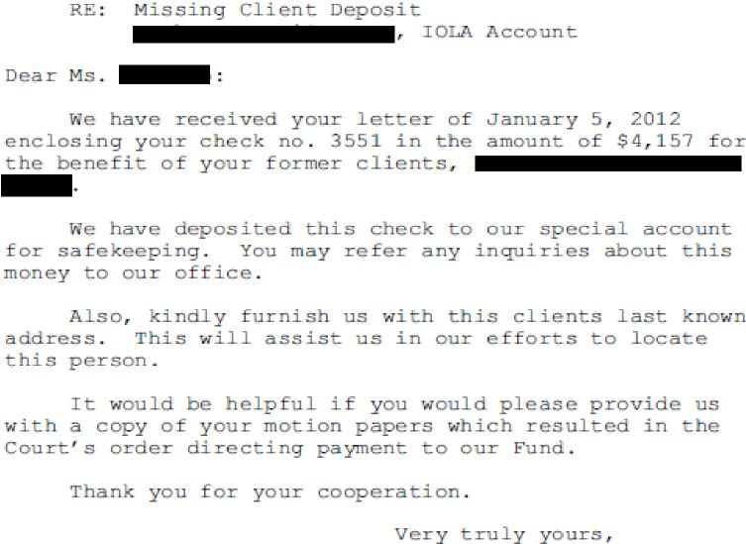
Missing Client/Deceased Attorney Escrow
Intake Protocol
Check is deposited in SEPARATE interest-
bearing trust account.
Funds are deposited separate from the
Fund’s reimbursement program/assets.
Each deposit is acknowledged by mail and
the information recorded in a unique
database.
A file folder is created under the name of
the attorney/firm making the deposit.
When necessary, deposits for multiple
clients are given their own sub-folders.

Slide 14
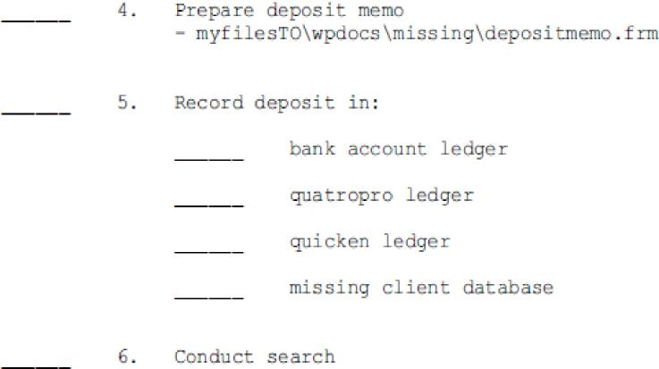
Missing Client/Deceased Attorney Escrow
Search/Refund Protocol We request last known address or other information on the beneficial owner if available.
We use national databases to attempt to locate owner(s). We will write to beneficial owner with instructions on how to request a refund. Information requested often includes proof of identification (driver’s license, etc.), and a notarized letter or affidavit. Refund memorandum prepared. Check prepared and recorded with file.

Slide 15
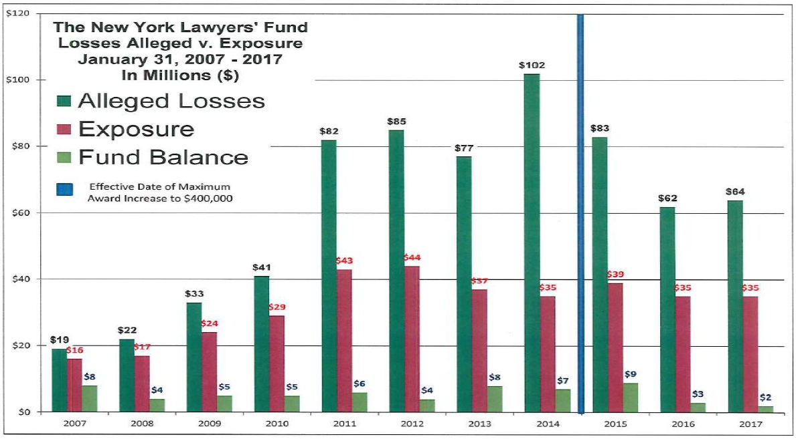

Slide 16
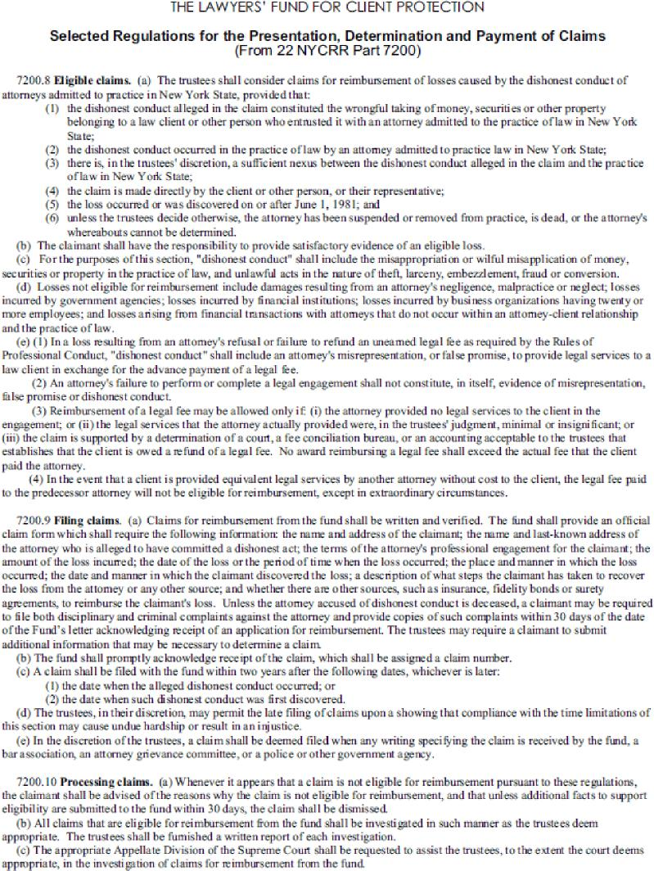
In 2017:
7200.4 Powers of trustees. In the exercise of the authority granted the trustees, the trustees have the power to:
(a) receive, hold, manage and distribute 50 per centum of the monies collected pursuant to the provisions of section 468-a of the Judiciary Law and such other monies as may be credited or otherwise transferred from any other fund or source, pursuant to law, including voluntary contributions together with any interest accrued thereon. All deposits of such revenues not otherwise required for the payment of claims shall be secured and invested as required by the provisions of section 97-t of the State Finance Law. For purposes of this subdivision, monies "transferred from any other fund or source" shall include monies paid to the Lawyers' Fund for Client Protection pursuant to Rules 1.15 (f) and 1.15 (g) of the Rules of Professional Conduct (22 NYCRR Part 1200), including earned interest, except that such monies shall not be available for use by the Lawyers' Fund unless the Fund is unable to ascertain the identify of the person or persons entitled to such monies or, during the five years following payment of such monies to the Fund, the Fund has been unable to locate that person or persons, and no valid claim has otherwise been made upon such monies. The Lawyers' Fund's use of such monies shall not extinguish a future valid claim to such monies by persons entitled thereto;

Slide 17
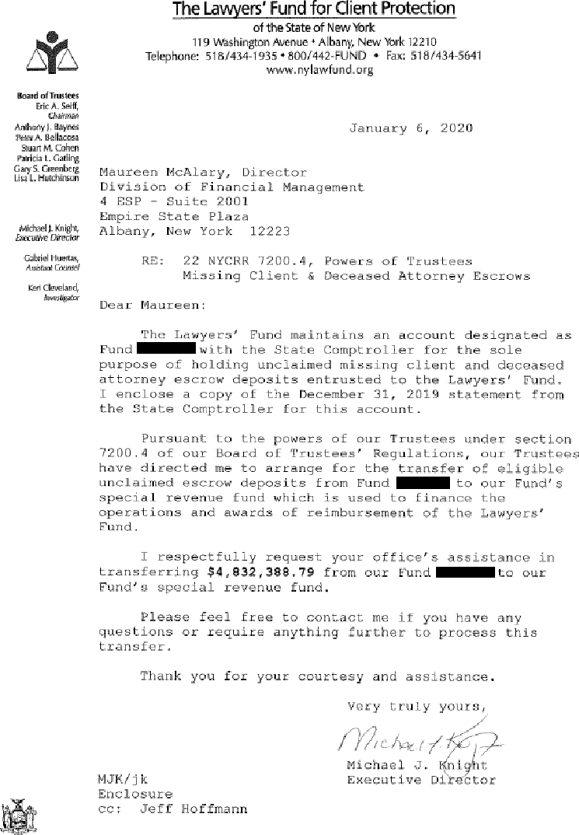
Sweep Protocol
NY Fund 2017 Regulation Amendment
Quarterly reports to Trustees on overall balance
and eligible balance for transfer.
Held for over 5 Years
“Unknown” Deposits
Accrued Interest Income
Written request is made to the OCA Division of Financial Management which then transfers
funds to our Special Revenue account*.
While we make beneficial use of transferred
funds, the debt owed to the law client is never
extinguished.
* The decision to transfer funds is within the sole
discretion of the Board of Trustees.

Slide 18
Results:
Since 1994, the Lawyers’ Fund has restored nearly $2 million to over 700 missing clients.
Since 2017, the Lawyers’ Fund has made use of over $16.5 million
for the benefit of law client reimbursement awards.

Slide 19
We Can’t All Be New York… And That’s Okay.

Slide 20
Part Deux: Lemons to Lemonade
Claims to the Fund
Succession Planning & Trusteeships
Iowa’s Experience
Lawyer regulation configuration
Demographics
Cropping up of the unclaimed funds issue
Disposition of inactive client balances, stale outstanding checks
Option A : immediate return at the end of the matter
Option B : regular or cashier’s check
Option C : The Great Iowa Treasure Hunt (GITH)
Client Trust Account (CTA)
Audit Program

Slide 21
Part Deux: Lemons to Lemonade
The Tentative Plan
Objective : create an alternative to the GITH for attorneys and trustees
The Road to Implementation
Refuse to reinvent the wheel
Quantify the need
Take stock of your strengths
Identify roadblocks
Establish a timeline and estimated time of completion
Sell the necessary parties on the proposition
Draft the rule
Build the mechanism
Green light the rule
Advertise the option
- Take a victory lap for client protection -

Slide 22
Part Deux: Lemons to Lemonade
Clients’ Funds
Attorneys’ Trust Accounts
LTAC
Legal Services Organizations
Iowans in Need
2024 – Thirteen grants awarded, $870,244 (!)

Slide 23
Part Deux: Lemons to Lemonade
Who benefits from a “Plan B” rule?
The Fund benefits in terms of lowered auditing and receivership costs, as well as a pot of money to repay claims from for a period of time.
The Bar benefits by having a simpler submission mechanism without a three-year waiting period, it allows the lawyers to easily get into compliance with the prompt return requirement (the number one violation we see at audit), and it reduces the costs of administration of an attorney’s estate.
The Clients benefit by having an easier mechanism to recover unearned attorney fees, especially certain types of clients*.
The Public benefits from IOLTA grants.
Other reasons you want to do this:
Claims drought means available staffing and money resources, but not job or program security
Build on your succession planning rule &/or capacity!

Slide 24
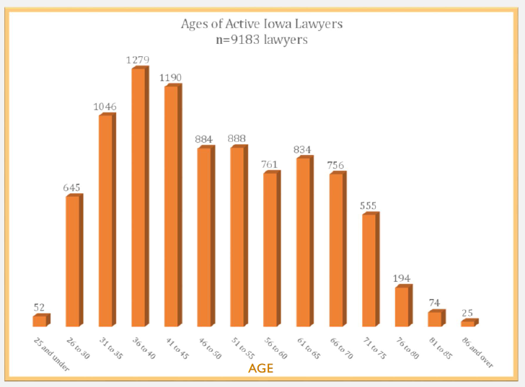
The Problem We’re (All) Facing
Part Deux: Lemons to Lemonade
2007 NOBC-APRL Report on Aging in the Legal Profession
“.. the current rules and procedures for lawyer regulation systems are not as well suited as they could be to protect the dignity of those senior lawyers who suffer from age related impairments..”
“.. the current rules also do not adequately protect the clients who maybe vulnerable to adverse consequences when an age related impairment significantly affects their lawyer’s ability to continue in active law practice.”

Slide 25
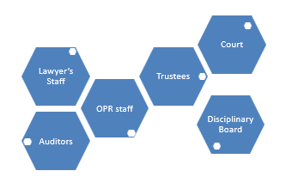
Part Deux: Lemons to Lemonade
What’s SHERPA?
Succession Help and Retiring Practitioner’s Assistance
More than one kind of attorney needing help on the practice mountain
More than one kind of guide
Funding made possible by Iowa Ct. R. 39.3(4)(j) 39.3(4) Powers and duties of commission relating to the fund. The commission, in addition to the powers granted elsewhere in this chapter, also has the following powers and duties: j. To fund programs that the commission believes will assist in preventing defalcations by attorneys.
Kinds of help provided through the program: template and exemplar trust account management forms, priority one-on-one auditor assistance, mentor match-up, trust accounts school, Shredtober

Slide 26
and in conclusion…

Slide 27
Questions?
Comments?
What’s Happening in Your Jurisdiction?

Slide 28
Thank you for attending!
Trinity M. Braun-Arana Director of Client Security Office of Professional Regulation 1111 E. Court Avenue Des Moines, Iowa 50319 (515) 348-4670 ext. 3 trinity.braun-arana@iowacourts.gov | Michael J. Knight, Sr. Executive Director & Counsel NYS Lawyers’ Fund for Client Protection 119 Washington Avenue Albany, New York 12210 (800) 442-3863 mjk@nylawfund.org

